Slide 1
The HRI Design Process of bothoven
A collaborative Project by john Halloran and Jason Arnold

Slide 2
Needfinding

Slide 3
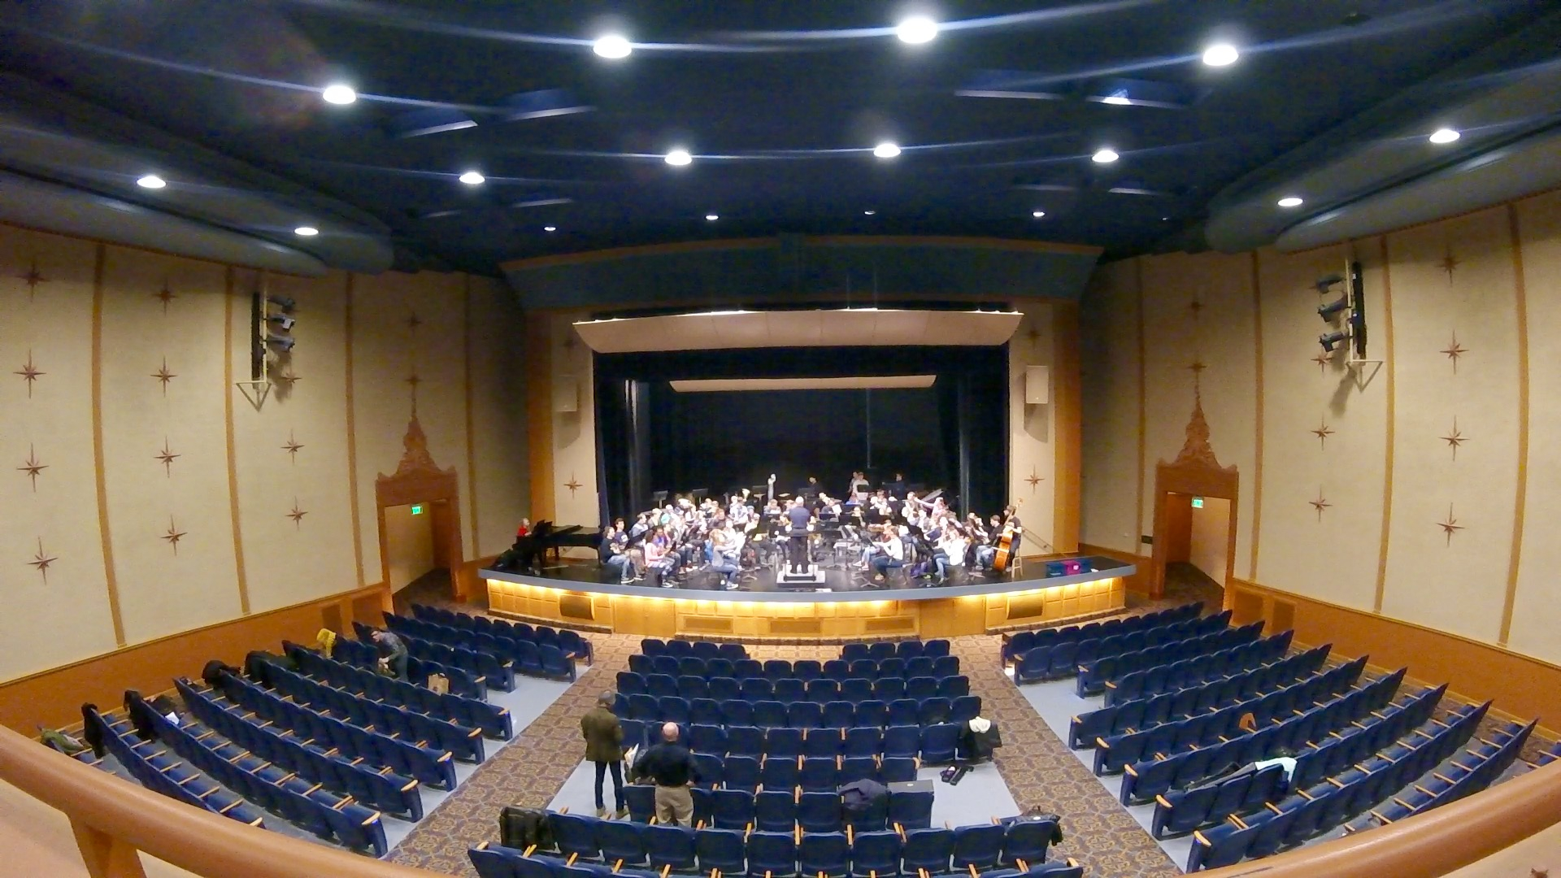
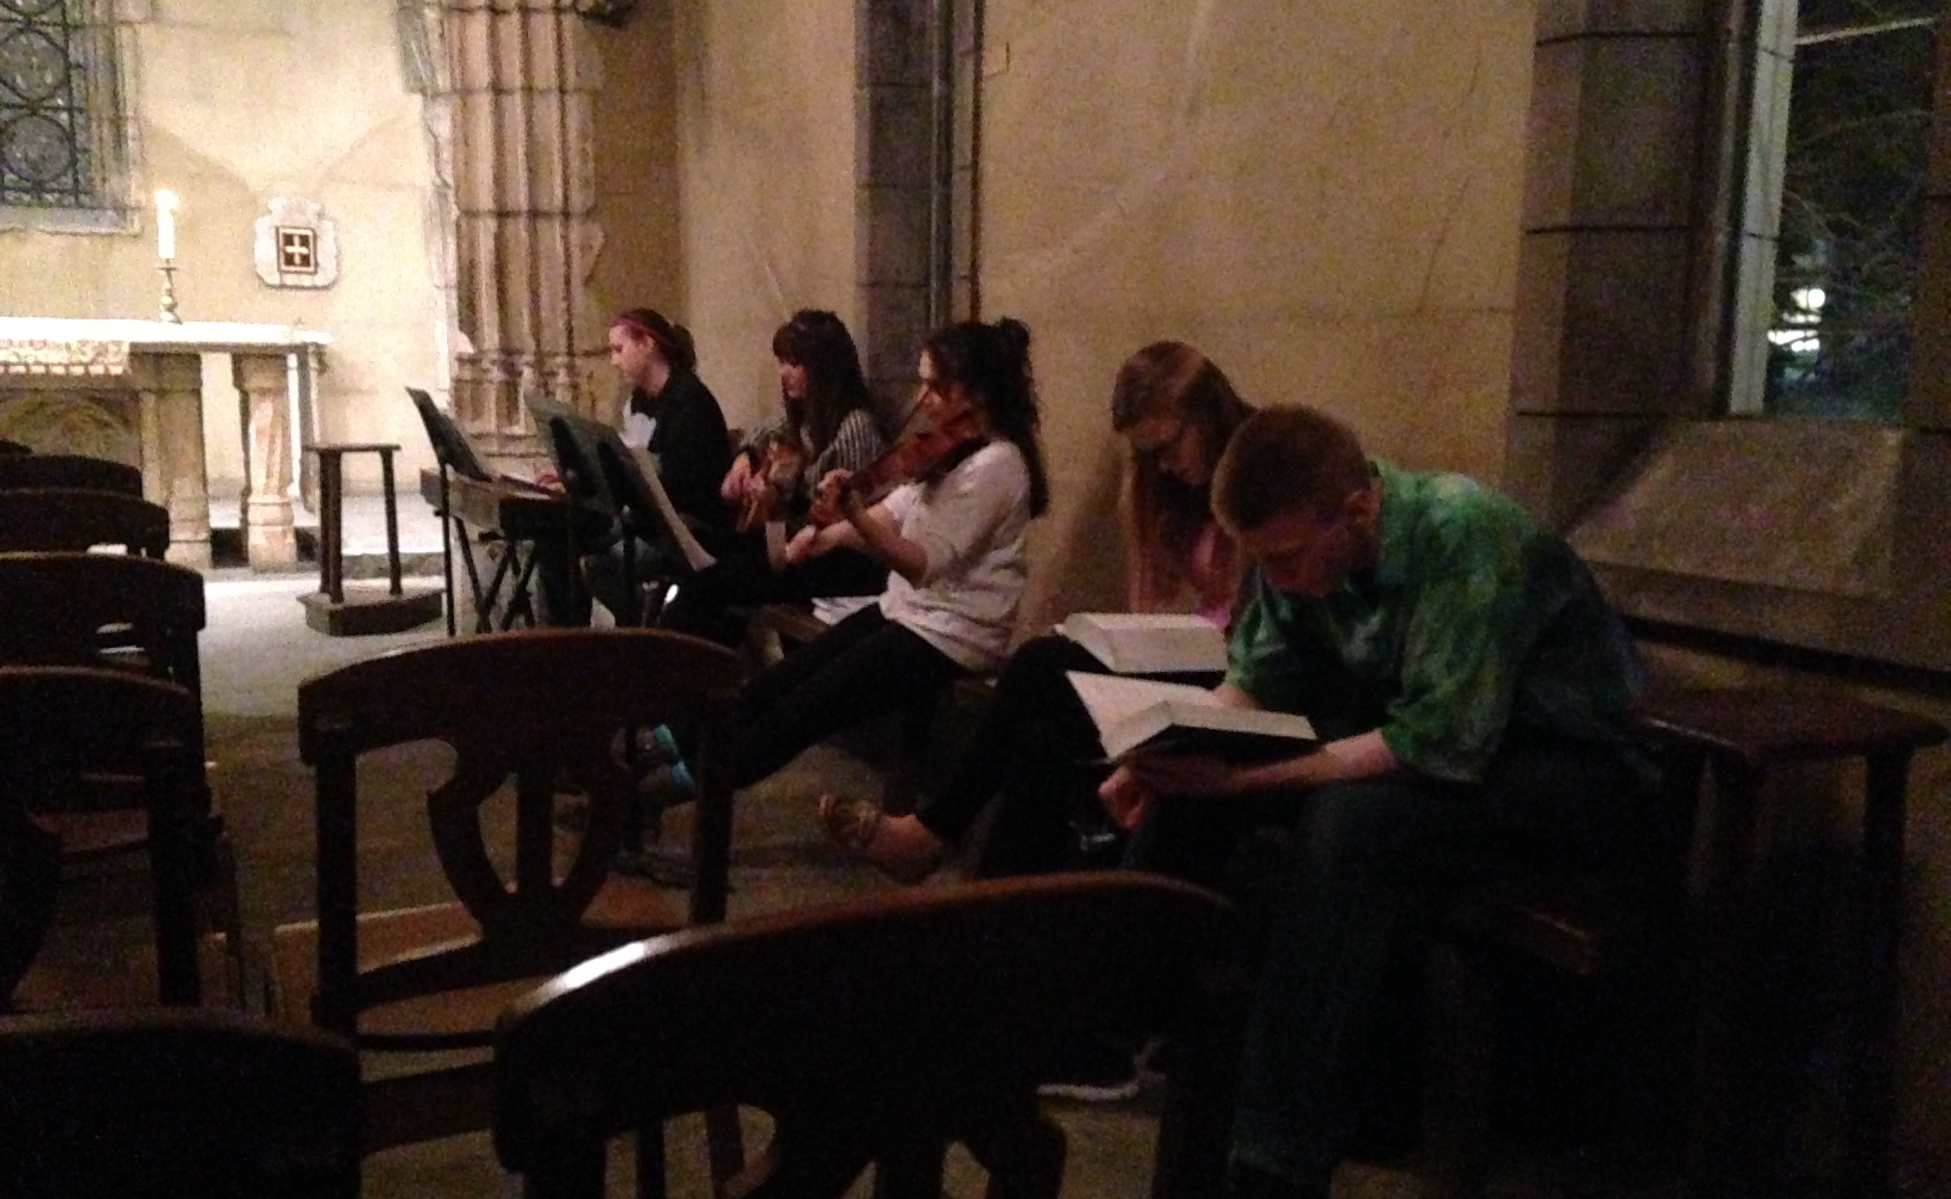
Empathy: Environments
Wind Ensemble: Varsity Theater
Chapel Choir: St. Joan Of Arc

Slide 4
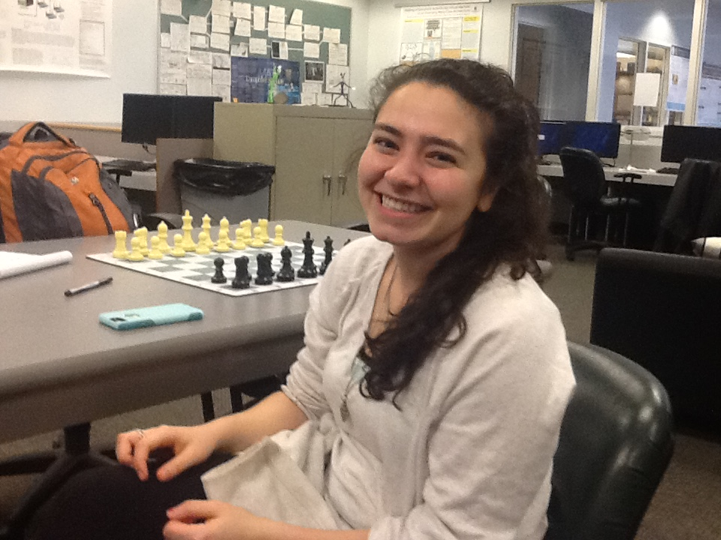
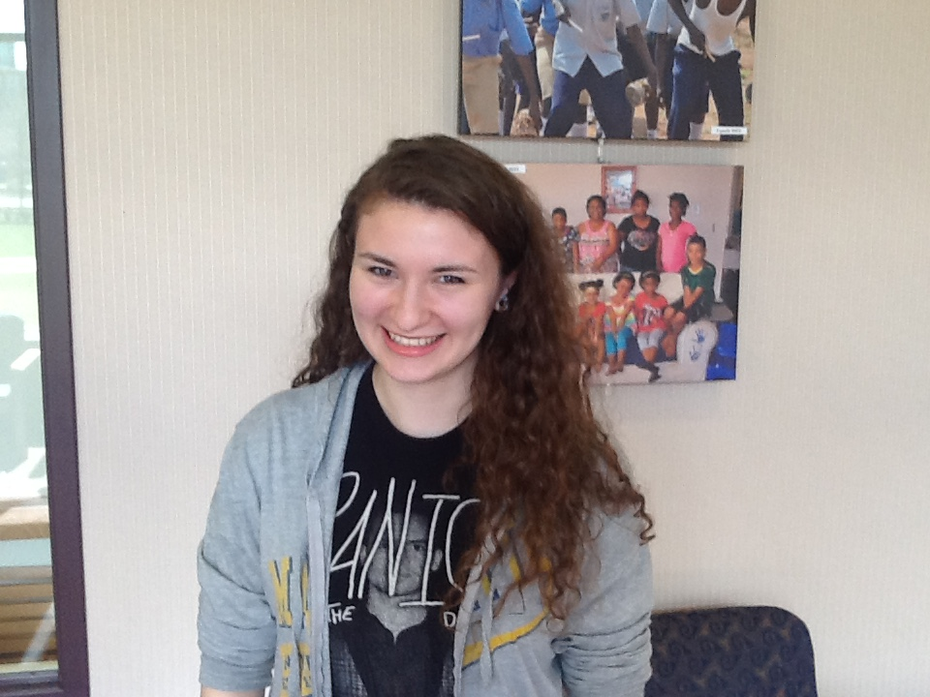
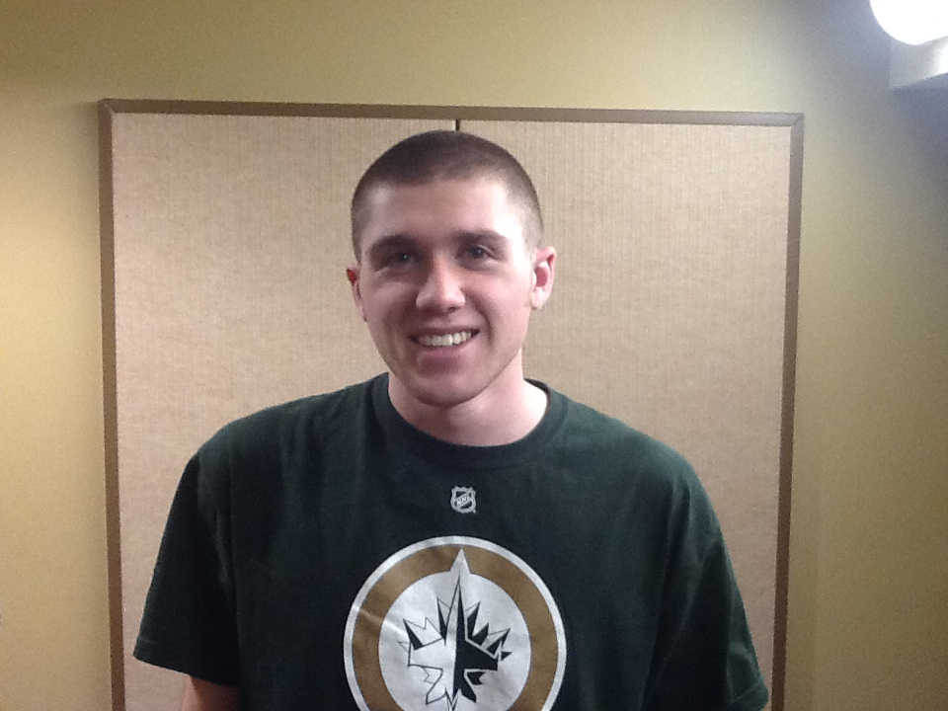
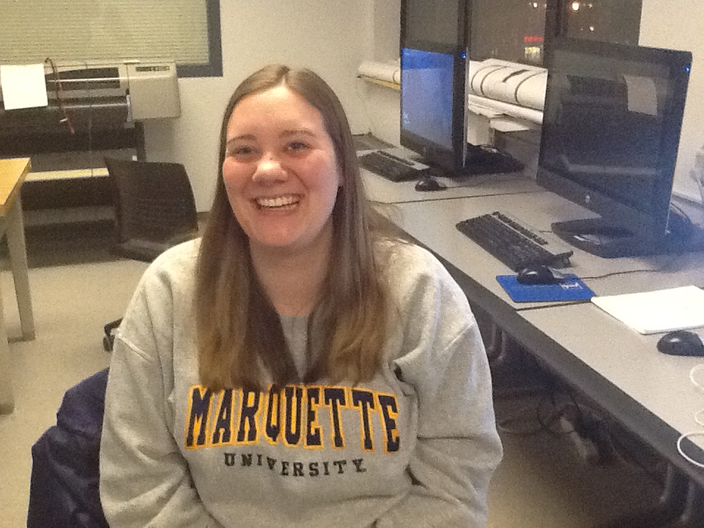
Empathy: Musicians
Cristina
Jessica
John
Megan

Slide 5
Purpose
What does a practice routine even look like?
What do musicians need?
Should we address issues in the ensemble or the private practice room?
What issues in both could be addressed?

Slide 6
What was found?
Greatest need was in the private practice room
Why? Because in an ensemble setting, rehearsals need to be run by a human otherwise the music loses the human aspect of performing.
Needs included
More physical timekeeping
Ability to listen oneself to hear mistakes
Addressing motivational problems – Self-Confidence/Self-Efficacy

Slide 7
Sketching and storyboarding

Slide 8
Sketches

Slide 9
SketCHes

Slide 10
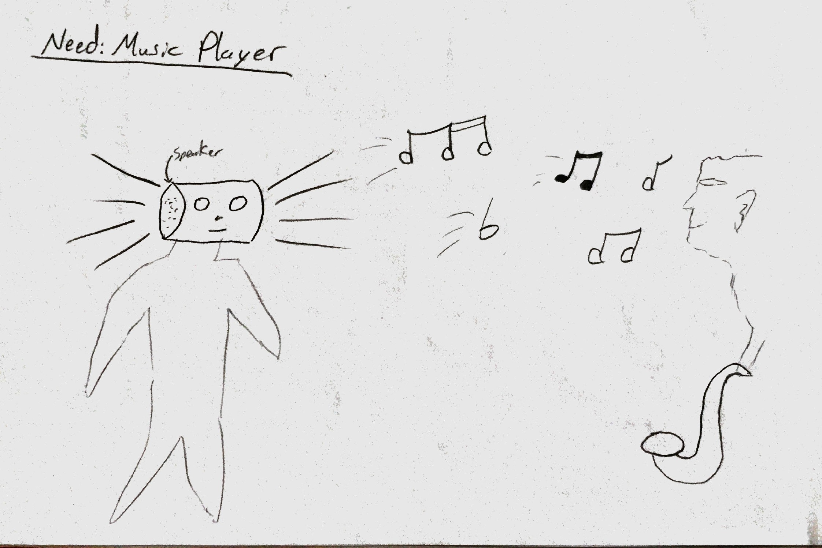
Sketches

Slide 11
Storyboard

Slide 12
The gains from sketching and storyboarding
A better gauge of what the human robot interaction looks like
The commonality of what our team thought about
What actually looks feasible to solve
We had one sketch where the robot danced but we knew with time constraints and the current technology this would not be feasible
It is feasible to create a simple conducting robot to keep time, record sound, and play it all back.

Slide 13
Prototyping and Improvising

Slide 14
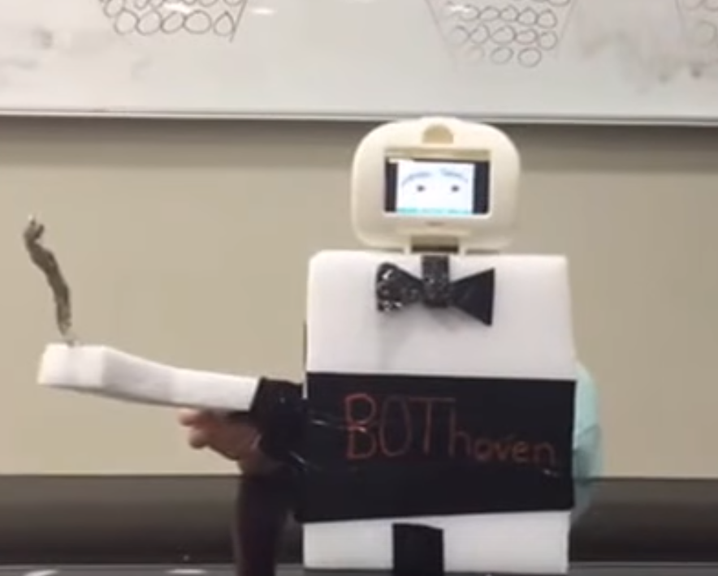
Bothoven prototype

Slide 15
Our REACTIONS
Prototype addressed conducting
Careful consideration was given to the prototype to put emphasis on the conducting arm
Conducting motion is incredibly important
If a final designed were to be made, it would not be a full body it seems since it only needs one arm to conduct
It could be argued that it should still have a full body to make the robot look more like a human conductor

Slide 16

Building with the Nao

Slide 17
Hopes for the future
This project hopefully laid some of the ground work for the future of this idea
New model could be built that focuses more on the needs which like we have stated perhaps just a torso, head, and one arm to maximize the purpose of the robot
Obviously, the robot should become more personalized and fit more individual needs and customization based on the player
Jazz
Classical
Improv

